Slide 1
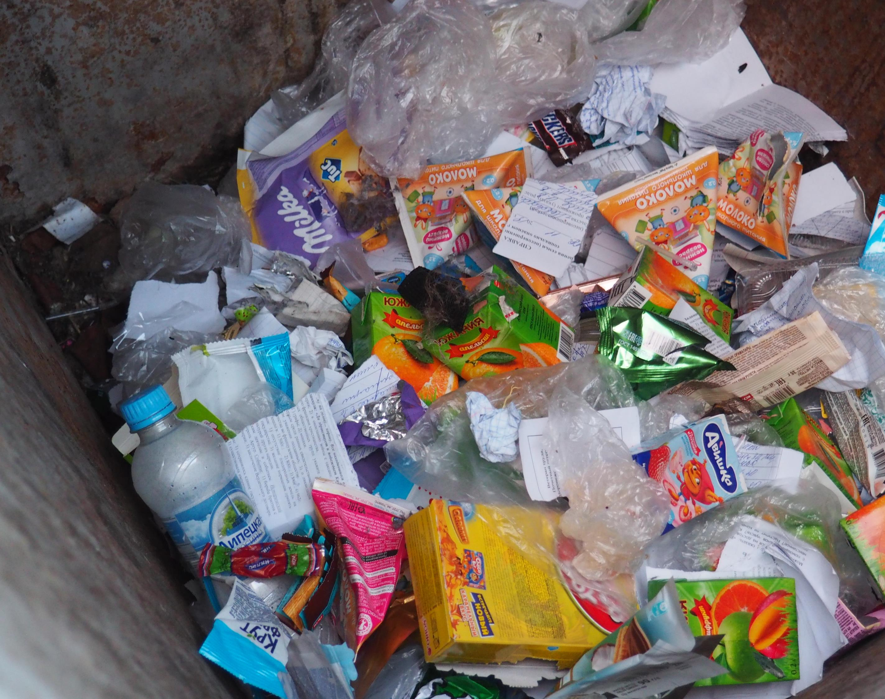
GLOBAL BEST PRACTICES ON EPR
Sebastian Frisch
BlackForest Solutions GmbH
20th March 2023

Slide 2
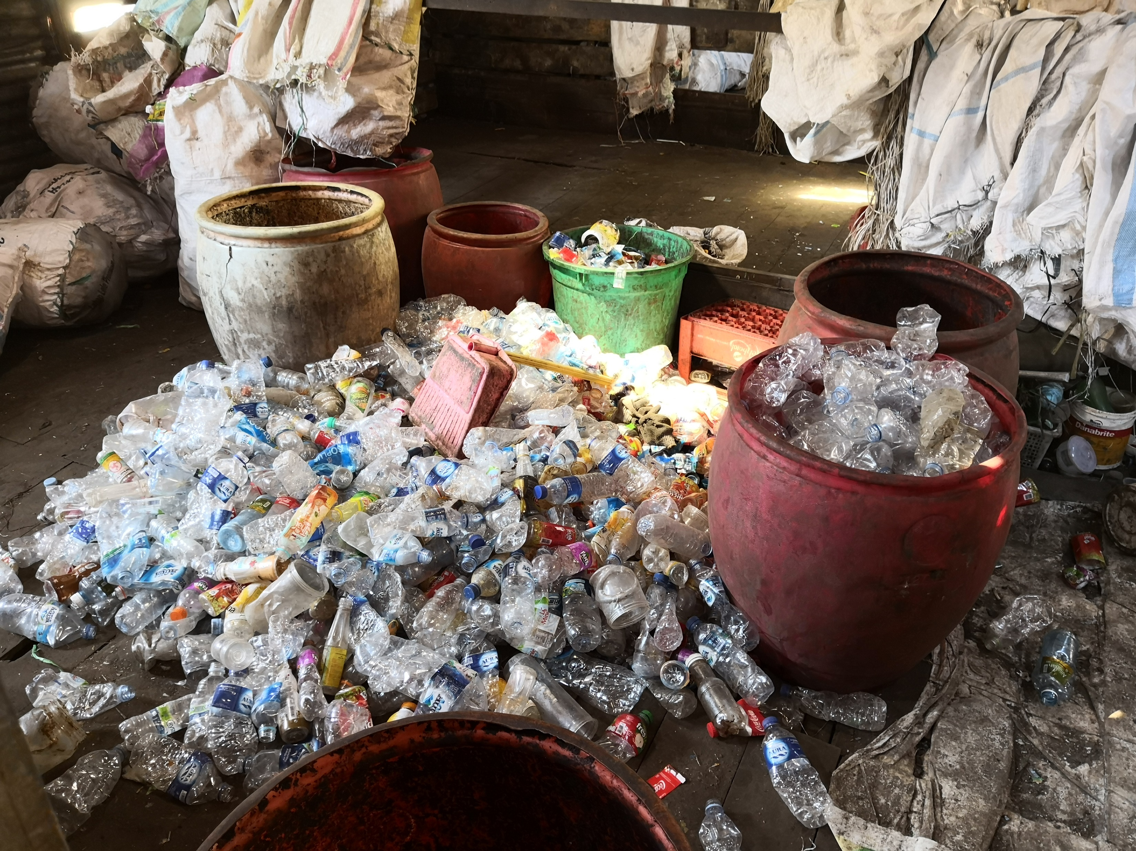
Agenda
Introduction BlackForest Solutions
What is Extended Producer Responsibility (EPR)?
Experiences from the German EPR Packaging System
The French EPR System - CITEO
Europe EPR Program Comparison
source: BlackForest Solutions

Slide 3
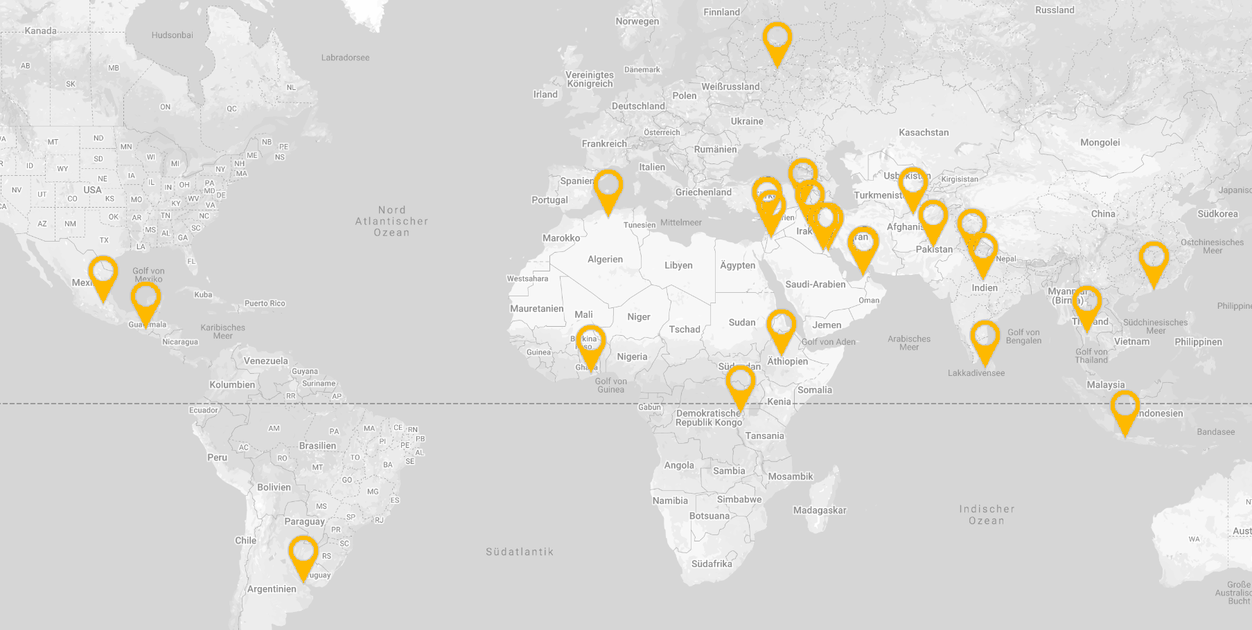
Tailored A-Z waste management solutions
WEEE PRO OPERATOR IN INDIA. Implementation partner in Egypt, Algeria
- Consortium with GIZ GmbH
More than 200 consultancy projects in fields of hazardous & non-hazardous waste management.

Slide 4
Definition of Extended Producer Responsibility
An environmental policy approach in which a producer’s responsibility for a product is extended to the post-consumer stage of a product’s life cycle
Source: OECD https://www.oecd.org/env/tools-evaluation/extendedproducerresponsibility.htm
“Polluter pays“ principle
Cost not to be covered by municipal waste fees to citizen
No cost for municipalities
No cost for last user / at the point of „disposal“
= Producers to finance collection, sorting and recycling

Slide 5
What is a PRO?
PRODUCER RESPONSIBLITY ORGANISATION
The vehicle to operate a collective producer responsibility
The link between stakeholders, allowing them to focus on their core business
legal entity which organises the compliance of producers with EPR obligations and/or targets
Offers a more cost-efficient solution than individual EPR solutions on the basis of identical achievements. It is also sometimes mandatory to join a PRO.

Slide 6
PRO SETUP - BASIC FLOW AMONG STAKEHOLDERS
PRODUCERS
EEE/BATTERIES/PACKAGING
SERVICE
for registrations, declarations, reporting, collection and treatment of waste EEE, packaging and batteries, documentation
DATA & FINANCING
CONTRACT FOR TREATMENT
CONSUMER/ PROFESSIONAL USERS
INFORMATION
PRODUCER RESPONSIBILITY ORGANIZATION „PRO“
SORTING AND RECYCLING
RECYCLING CERTIFICATES
RETURN OF WASTE
CONTRACT FOR COLLECTION
COLLECTION CERTIFICATES
COLLECTION
source: LANDBELL GROUP

Slide 7
Territory
The territory where the EPR initiative must be taken into consideration in order to design a practical solutions.
Is EPR to be deployed at national level? Local level? Regional level?
What are the characteristics of the territory?
Geography, demography, economy, infrastructures available…
What particular challenges are to be considered?
EPR is not « one size fits all »!

Slide 8
experiences from the german epr packaging system

Slide 9
The German EPR System
10 system operators
System operator 1
Producer
Participation in the EPR scheme or take-back
System operator 2
Competition
Waste disposal service provider
Competition
Financial responsibility
(100 %)
Shareholding
System operator n
source: EPR MENA Broschure

Slide 10
german packaging epr
Scope of the Regulations
WHO? The Producer (means the obliged company) is the first person commercially (also free of charge if applicable) providing b2c packaging filled with goods in Germany to a third party with the aim of distribution, consumption or use.
WHAT? Sales packaging is sales or service packaging which typically accumulates as waste for private households or equivalent sources of waste generation to these.

Slide 11
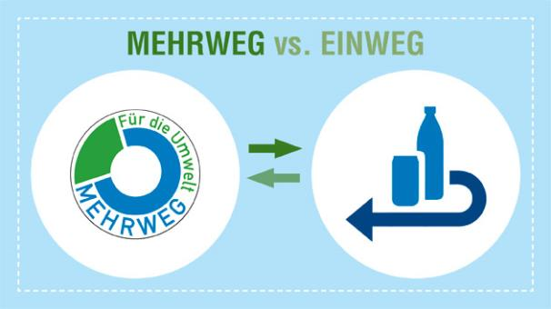
Extended Obligation for Beverage Packaging
NEW COMPULSORY DEPOSIT FOR FOLLOWING ONE-WAY DRINKS (§31)
Drinks with a whey content of more than 50 %
Carbonated fruit and vegetable drinks
ONE WAY / REUSABLE : CLEAR MARKING AND VISIBLE CUSTOMERS INFORMATION ON POINT OF SALE (§32)
Applies to mail order shopping, stationary and online retailers
source: LANDBELL GROUP,
BlackForest Solutions

Slide 12
Duties for Notification for Producers
... before putting packaging into circulation
1.
2.
3.
4.
System Participation (or evtl. industry solutions)
Registration
Quantity Reports
Declaration of Completeness
Dual System
Central Agency | ZSVR LUCID
+
Publication of ALL registered manufacturers/distributors by the Central Office = full transparency
source: LANDBELL GROUP,
BlackForest Solutions

Slide 13
Obligation of Data Reports (§ 10)
Producers are also obliged to immediately transmit to the Central Office all the packaging information they also provided to their compliance scheme within the scope of their contract, specifying at least the following data - incl. subsequent quantity changes:
1. Type of material and weight of packaging;
2. Name of the system where system participation is effected;
3. Period of contract and reporting frequency
No quantity thresholds for reporting to the Central Office! Quantity thresholds only in Declaration of Completeness (§ 11)
Easy matching of data with system reports is possible - because both data reports go to the Central Office = Transparency.
source: LANDBELL GROUP,
BlackForest Solutions

Slide 14
Fines
In case of non-registration, or of distribution of goods where the manufacturer has not correctly registered the brands they are distributing, there is a potential fine of up to 100,000 EUR
non-participation in a compliance scheme may be punished with a fine of up to 200,000 EUR.
Failure to report packaging data to the Zentrale Stelle will result in fines of up to €10,000€
Failure in the submission of the Declaration on completeness may result to fines of up to €100,000

Slide 15
The French EPR System - CITEO
Monopoly for proposal
Producer
Participation in the EPR scheme or take-back
CITEO
Financial responsibility
(80 %)
Organisational responsibility is transferred from CITEO to the local authorities
Shareholding
Municipality 1
Financial responsibility
(20 %)
Waste disposal service provider
Municipality 2
Municipality 3
Competition
source: EPR MENA Broschure

Slide 16
europe epr program comparison
 | Germany | France | Portugal
Program Scope | Residential some IC + I | Residential some away from home | Residential IC + I
Cost coverage | Full | Partial | Partial
Profit/ Non-Profit | For Profit | Not for profit | Not for profit
Awareness Role | Low | High | medium
Funding | Fees | Modulated fees | Fees
Competition/ Monopoly | Competition | Monopoly | Competition
PRO Governance | Shareholder | Shareholder + State | Shareholders
Recycling rate (2017) | 69,9 % | 68,1 % | 55,3 %
source: LANDBELL GROUP,
BlackForest Solutions

Slide 17
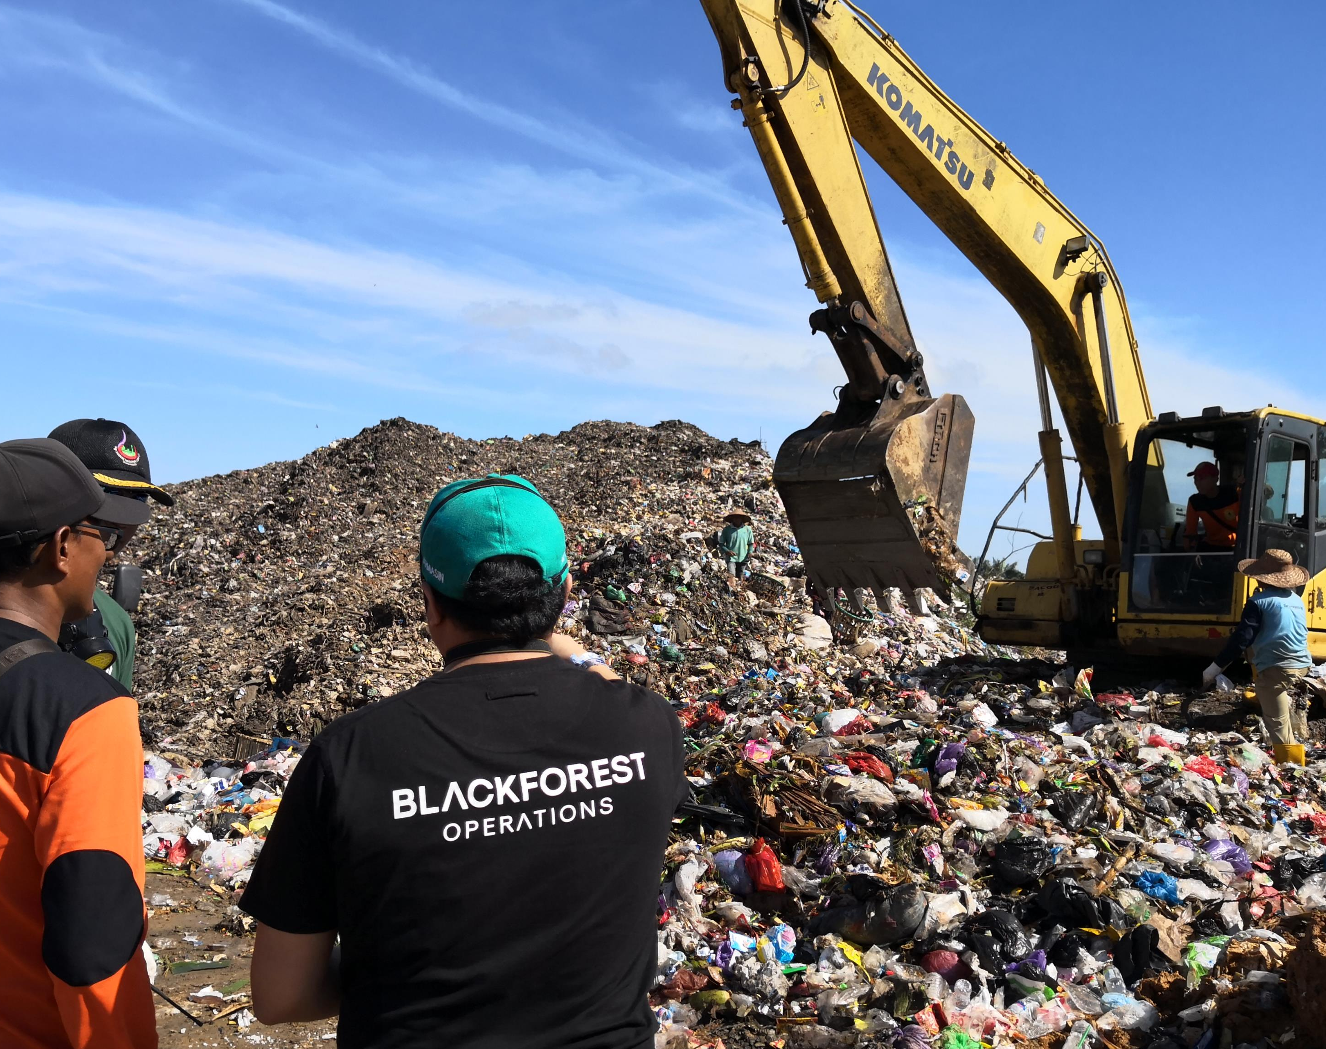
Thank you for your attention!
www.blackforest-solutions.com

